Slide 1
EVENTS
ADV-C6

Slide 2
What is an event? EVENT is a trigger or action that makes something happen. Meaning to tell our program what should happen when User does some action triggering an event.
Any program that uses GUI (graphical user interface) such as Javascript application written for windows, is event driven. Event describes the change in state of any object.
Components of Event Handling: Event handling has three main components,
Events : An event is a change in state of an object.
Events Source : Event source is an object that generates an event.
Listeners : A listener is an object that listens to the event. A listener gets notified when an event occurs.
How Events are handled?
A source generates an Event and send it to one or more listeners registered with the source. Once event is received by the listener, they process the event and then return.

Slide 3
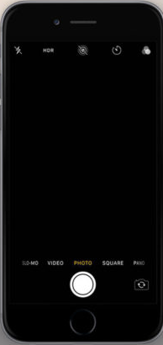
For example: The camera App.
Event:
Clicking of the capture button
Action:
Upon pressing the capture button, we are sending signal to the camera to take the picture and the picture will be appearing on the screen.

Slide 4
Similarly, Some Computer keyboard events are Press of a Key whereas some Mouse events are Push of Mouse Left or Right button and Mouse Move.
Some Touchscreen events on a Tablet/iPad are Detecting Touch of screen and Touch Move Gestures These are the commonly known events we come across the most
One of the exciting things about coding is that you can make interactive programs. Anytime someone clicks, taps a computer or a phone it generates an Event and there is code that decides what to do when an event occurs.
Events are a great way to allow any person or User using or running your program to control the program in a way they want to; within predefined code that you as a programmer have written.
Computer programmers use events to build interactive games and apps.
Events are a useful concept in programming.

Slide 5
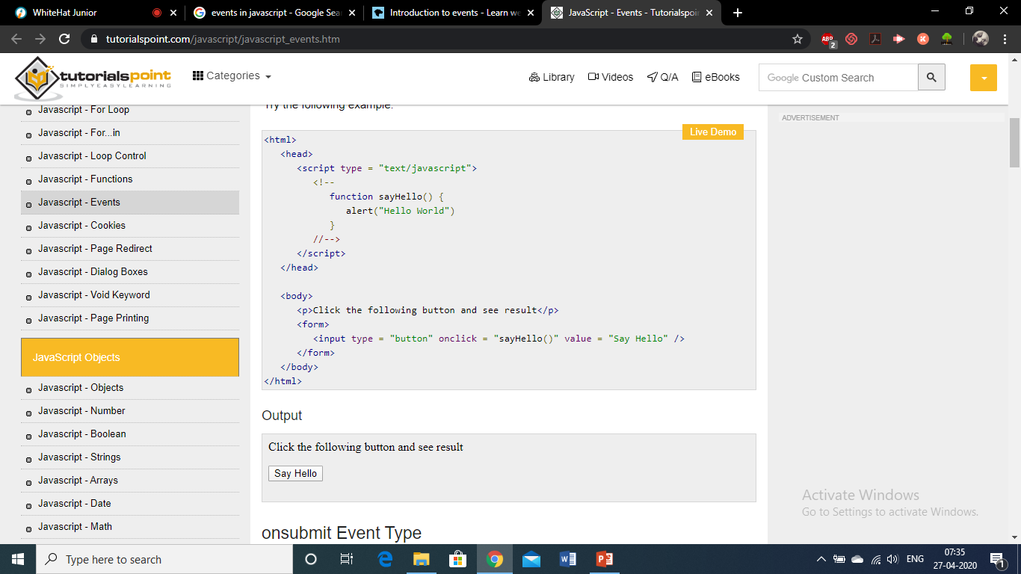
onclick Event Type (this is just an example)
This is the most frequently used event type which occurs when a user clicks the left button of his mouse. You can put your validation, warning etc., against this event type.

